Slide 1

Modeling with
modelr

Slide 2
Navigate to the 04-Model folder.
Open 04-Model-Exercises.Rmd

Slide 3

The basics

Slide 4
Models
A low dimensional description of a higher dimensional data set.
modelr

Slide 5
Models
Algorithm
Data
Model Function

Slide 6
Models
What is the model function?
Algorithm
Data
Model Function

Slide 7
Models
What uncertainty is associated with it?
Algorithm
Data
Model Function

Slide 8
Models
How "good" is the model?
Algorithm
Data
Model Function

Slide 9
Models
What are the residuals?
Algorithm
Data
Model Function

Slide 10
Models
What are the predictions?
Algorithm
Data
Model Function

Slide 11
Algorithm
Algorithm
Algorithm
Algorithm
Algorithm
Algorithm
Algorithm
Algorithm
Algorithm
Algorithm
Algorithm
Algorithm
Algorithm
Algorithm
Algorithm
Algorithm
Algorithm
Algorithm
Algorithm
Algorithm
Algorithm
Algorithm
Algorithm
Algorithm
Algorithm
Algorithm
Algorithm
Algorithm
Algorithm
Algorithm
Algorithm
Algorithm
Algorithm
Algorithm
Algorithm
Algorithm
Algorithm
Algorithm
Algorithm
Algorithm
Algorithm
Algorithm
Algorithm
Algorithm
Algorithm
Algorithm
Algorithm
Algorithm
Algorithm
Algorithm
Algorithm
Algorithm
Algorithm
Algorithm
Algorithm
Algorithm
Algorithm
Algorithm
Algorithm
Algorithm
Algorithm
Algorithm
Algorithm
Algorithm
Algorithm
Algorithm
Algorithm
Algorithm
Algorithm
Algorithm
Algorithm
Algorithm
Algorithm
Algorithm
Algorithm
Algorithm
Algorithm
Algorithm
Algorithm

Slide 12
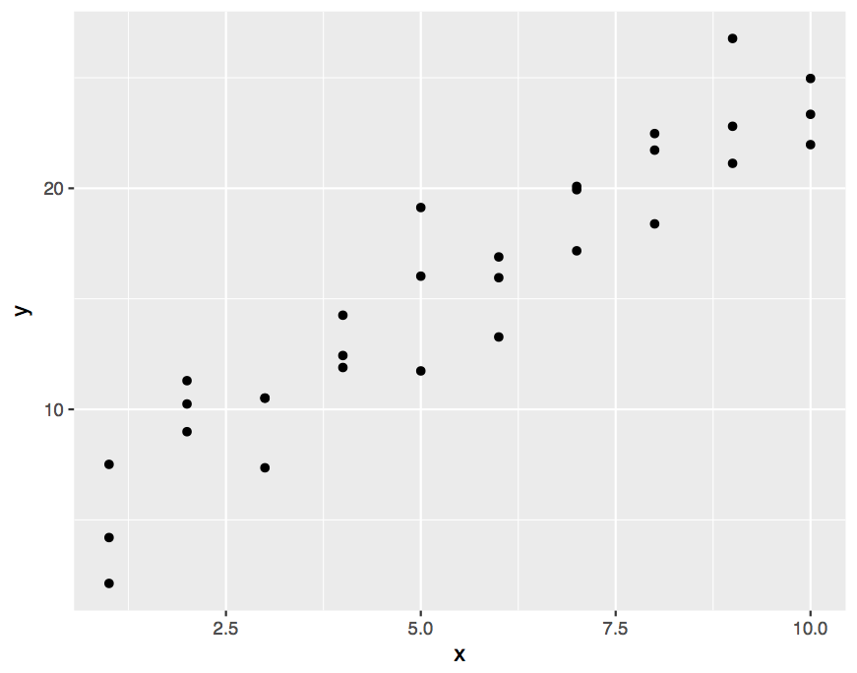
Example
modelr

Slide 13
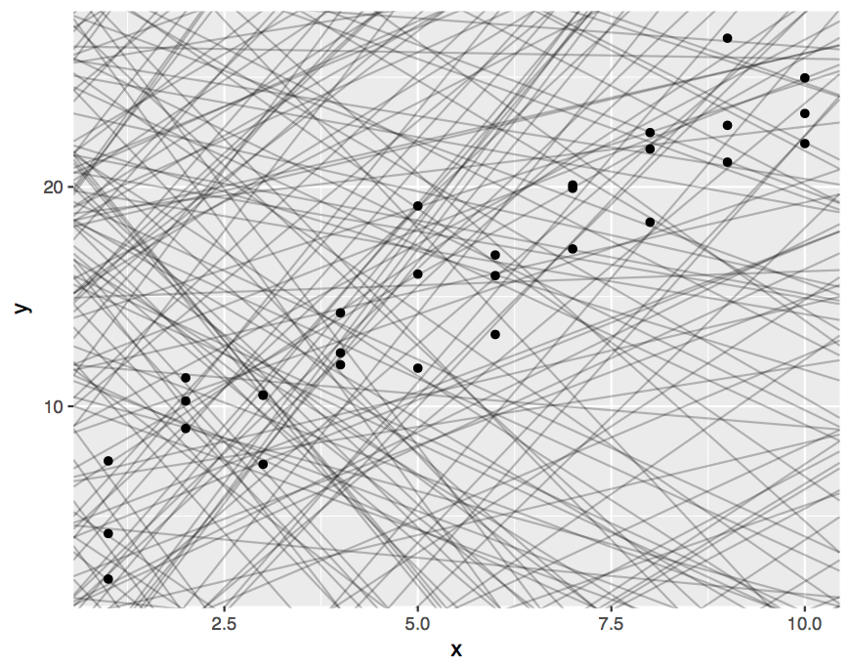
1. A family of functions
modelr

Slide 14
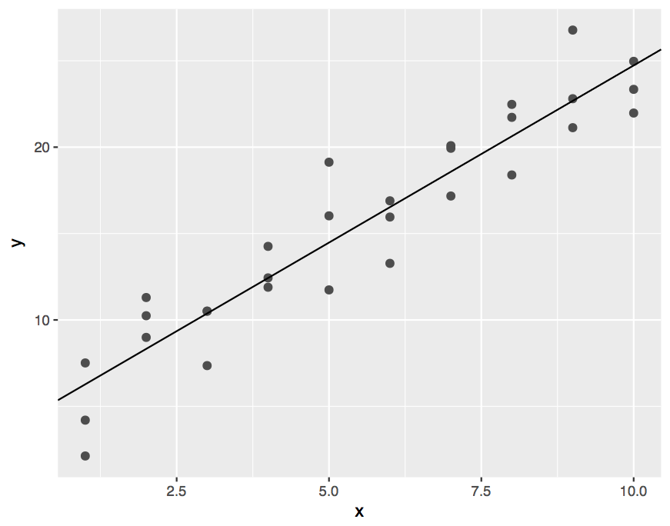
2. The best function of the family
modelr

Slide 15
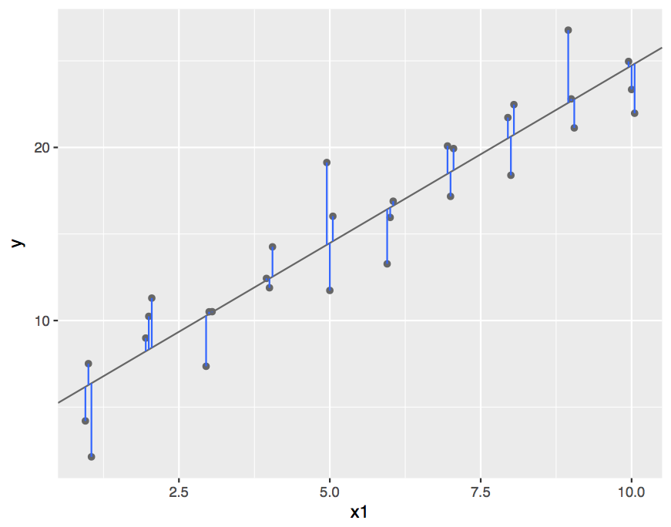
3. The residuals
modelr

Slide 16
(Popular) modeling functions in R
function | package | fits
lm() | stats | linear models
glm() | stats | generalized linear models
gam() | mgcv | generalized additive models
glmnet() | glmnet | penalized linear models
rlm() | MASS | robust linear models
rpart() | rpart | trees
randomForest() | randomForest | random forests
xgboost() | xgboost | gradient boosting machines
modelr

Slide 17
(Popular) modeling functions in R
function | package | fits
lm() | stats | linear models
glm() | stats | generalized linear models
gam() | mgcv | generalized additive models
glmnet() | glmnet | penalized linear models
rlm() | MASS | robust linear models
rpart() | rpart | trees
randomForest() | randomForest | random forests
xgboost() | xgboost | gradient boosting machines
modelr

Slide 18
modelr
Tidy functions that make it easier to work with models in R
# install.packages("tidyverse")
library(modelr)
wages <- heights %>% filter(income > 0)
modelr
modelr

Slide 19

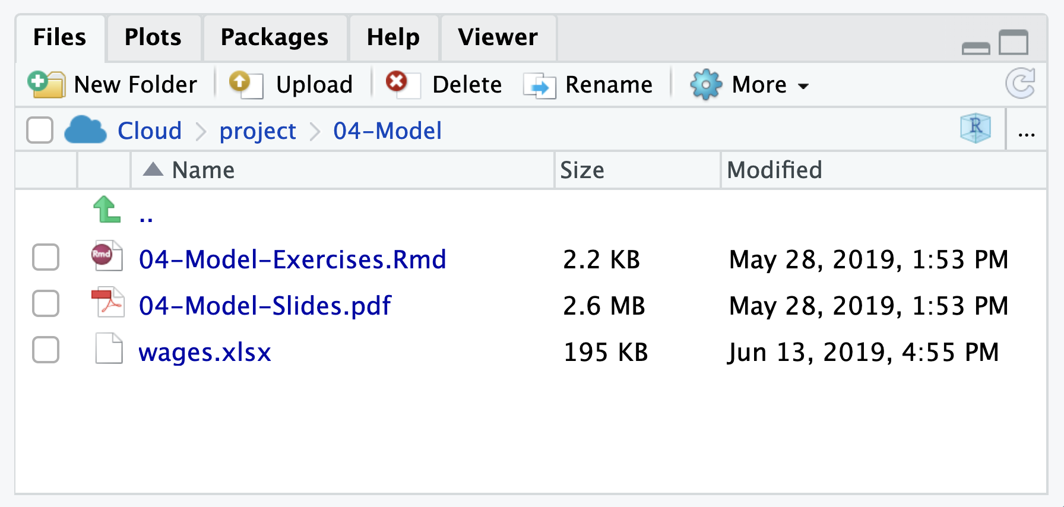
wages.xlsx
Income predictors extracted from the National Longitudinal Study, sponsored by the U.S. Bureau of Labor Statistics.
modelr

Slide 20

Your Turn 1
Change the working directory to 04-Models.
Then import wages.xlsx as wages and copy the code to your setup chunk.
Be sure to set NA: to NA.

Slide 21
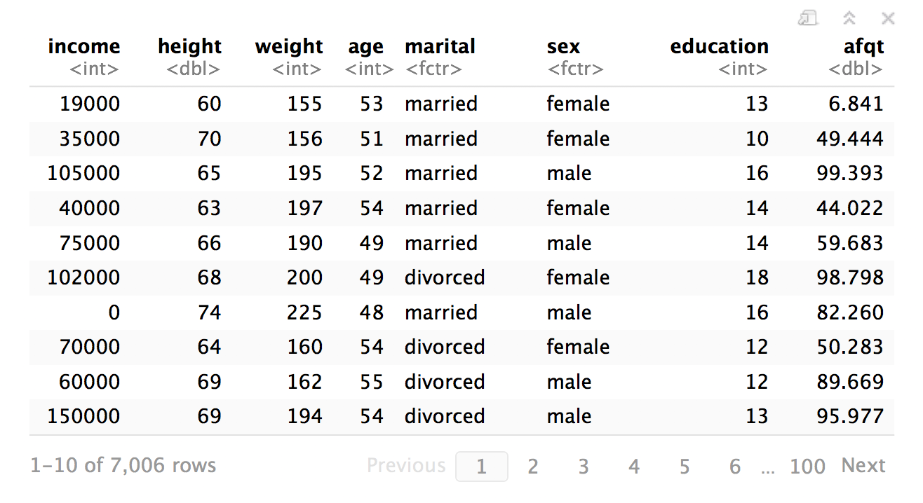
wages
modelr

Slide 22
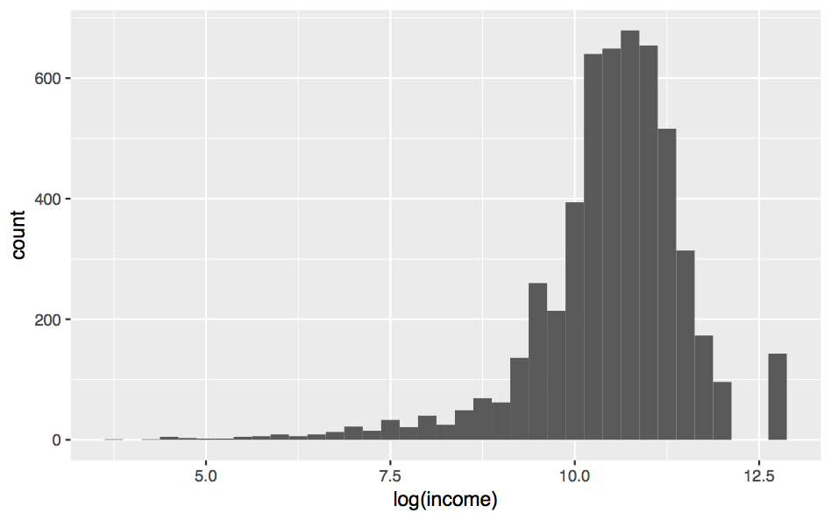
wages %>%
ggplot(aes(log(income))) + geom_histogram(binwidth = 0.25)
modelr

Slide 23
lm()

Slide 24
lm()
Fit a linear model to data
lm(log(income) ~ education, data = wages)
A formula that describes the model equation
The data set
modelr

Slide 25
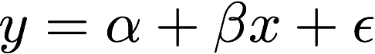


formulas
Formula only needs to include the response and predictors
y ~ x
y ~ x
Response
A tilde
The predictors
modelr

Slide 26
Your Turn 2
Fit the model below and then examine the output. What does it look like?
mod_e <- lm(log(income) ~ education, data = wages)

Slide 27
mod_e <- lm(log(income) ~ education, data = wages)
mod_e
## Call:
## lm(formula = log(income) ~ education, data = wages)
##
## Coefficients:
## (Intercept) education
## 8.5577 0.1418
class(mod_e)
## "lm"
Not pipe friendly to have data as second argument :(
Output is not tidy, or even a data frame

Slide 28
.
Use "." to pipe input to somewhere other than the first argument
mod_e <- wages %>%
lm(log(income) ~ education, data = .)
wages will be passed to here
modelr

Slide 29
broom

Slide 30
broom
Turns model output into data frames
# install.packages("tidyverse")
library(broom)

Slide 31
broom
Broom includes three functions which work for most types of models (and can be extended to more):
tidy() - returns model coefficients, stats
glance() - returns model diagnostics
augment() - returns predictions, residuals, and other raw values

Slide 32
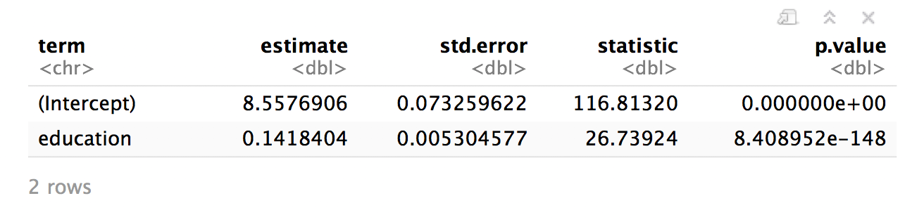
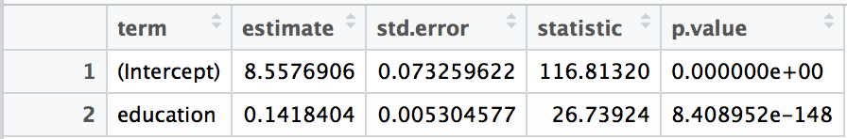
tidy()
Returns useful model output as a data frame
mod_e %>% tidy()

Slide 33
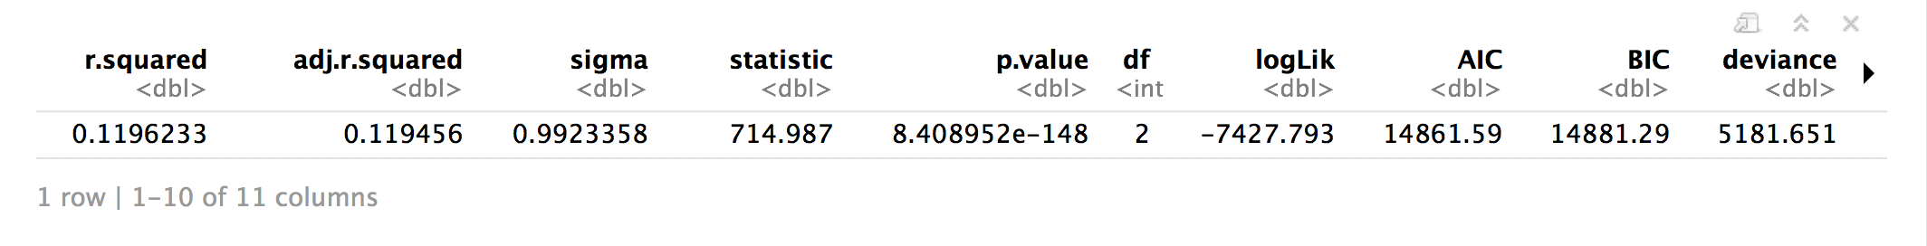
glance
Returns common model diagnostics as a data frame
mod_e %>% glance()

Slide 34
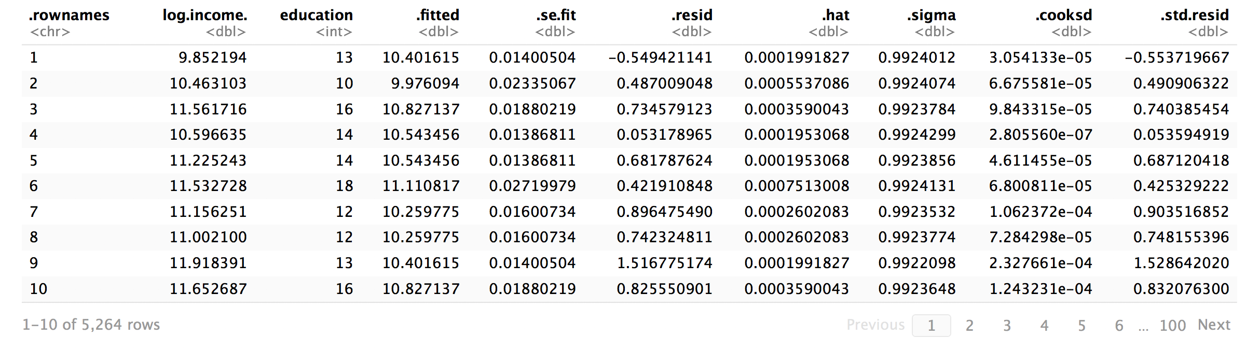
augment()
Returns data frame of model output related to original data points
mod_e %>% augment()

Slide 35
augment()
Returns data frame of model output related to original data points
mod_e %>% augment(data = wages)
Adds the original wages data set to the output

Slide 36

Your Turn 3
Use a pipe to model log(income) against height. Then use broom and dplyr functions to extract:
The coefficient estimates and their related statistics
The adj.r.squared and p.value for the overall model

Slide 37
mod_h <- wages %>% lm(log(income) ~ height, data = .)
mod_h %>%
tidy()
## term estimate std.error statistic p.value
## 1 (Intercept) 6.98342583 0.237484827 29.40578 4.129821e-176
## 2 height 0.05197888 0.003521666 14.75974 2.436945e-48
mod_h %>%
glance() %>%
select(adj.r.squared, p.value)
## adj.r.squared p.value
## 1 0.03955779 2.436945e-48

Slide 38
mod_h %>%
tidy() %>% filter(p.value < 0.05)
## term estimate std.error statistic p.value
## 1 (Intercept) 6.98342583 0.237484827 29.40578 4.129821e-176
## 2 height 0.05197888 0.003521666 14.75974 2.436945e-48
mod_e %>%
tidy() %>% filter(p.value < 0.05)
## term estimate std.error statistic p.value
## 1 (Intercept) 8.5576906 0.073259622 116.81320 0.000000e+00
## 2 education 0.1418404 0.005304577 26.73924 8.408952e-148
so which determines income?

Slide 39
multivariate
regression

Slide 40
To fit multiple predictors,
add multiple variables to the formula:
log(income) ~ education + height

Slide 41
mod_eh <- wages %>%
lm(log(income) ~ education + height, data = .)
mod_eh %>%
tidy()
## term estimate std.error statistic p.value
## 1 (Intercept) 5.34837618 0.231320415 23.12107 1.002503e-112
## 2 education 0.13871285 0.005205245 26.64867 7.120134e-147
## 3 height 0.04830864 0.003309870 14.59533 2.504935e-47

Slide 42

Your Turn 4
Model log(income) against education and height and sex. Can you interpret the coefficients?

Slide 43
mod_ehs <- wages %>%
lm(log(income) ~ education + height + sex, data = .)
mod_ehs %>%
tidy()
## term estimate std.error statistic p.value
## 1 (Intercept) 7.79 0.307 25.3 9.41e-134
## 1 2 education 0.148 0.00520 28.5 5.16e-166
## 1 3 height 0.00673 0.00479 1.40 1.61e- 1
## 1 4 sexmale 0.462 0.0389 11.9 5.02e- 32
What does this mean?
Where is sexmale?

Slide 44
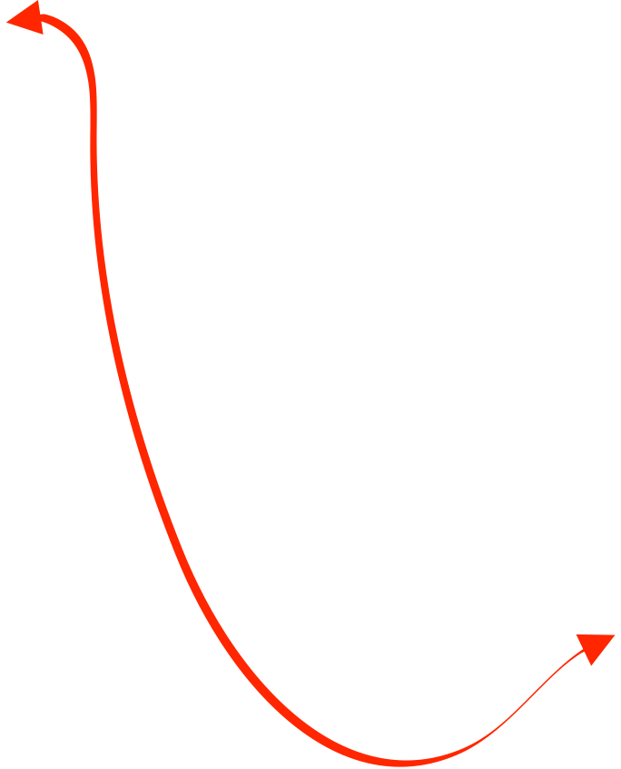
## term estimate std.error statistic p.value
## 1 (Intercept) 7.79 0.307 25.3 9.41e-134
## 1 2 education 0.148 0.00520 28.5 5.16e-166
## 1 3 height 0.00673 0.00479 1.40 1.61e- 1
## 1 4 sexmale 0.462 0.0389 11.9 5.02e- 32
Mean log(income) for a female (baseline) is:
log(income) = 7.79 + 0.15 * education + 0 * height
Mean log(income) for a male (baseline + adjustment) is:
log(income) = 7.79 + 0.15 * education + 0 * height + 0.46

Slide 45

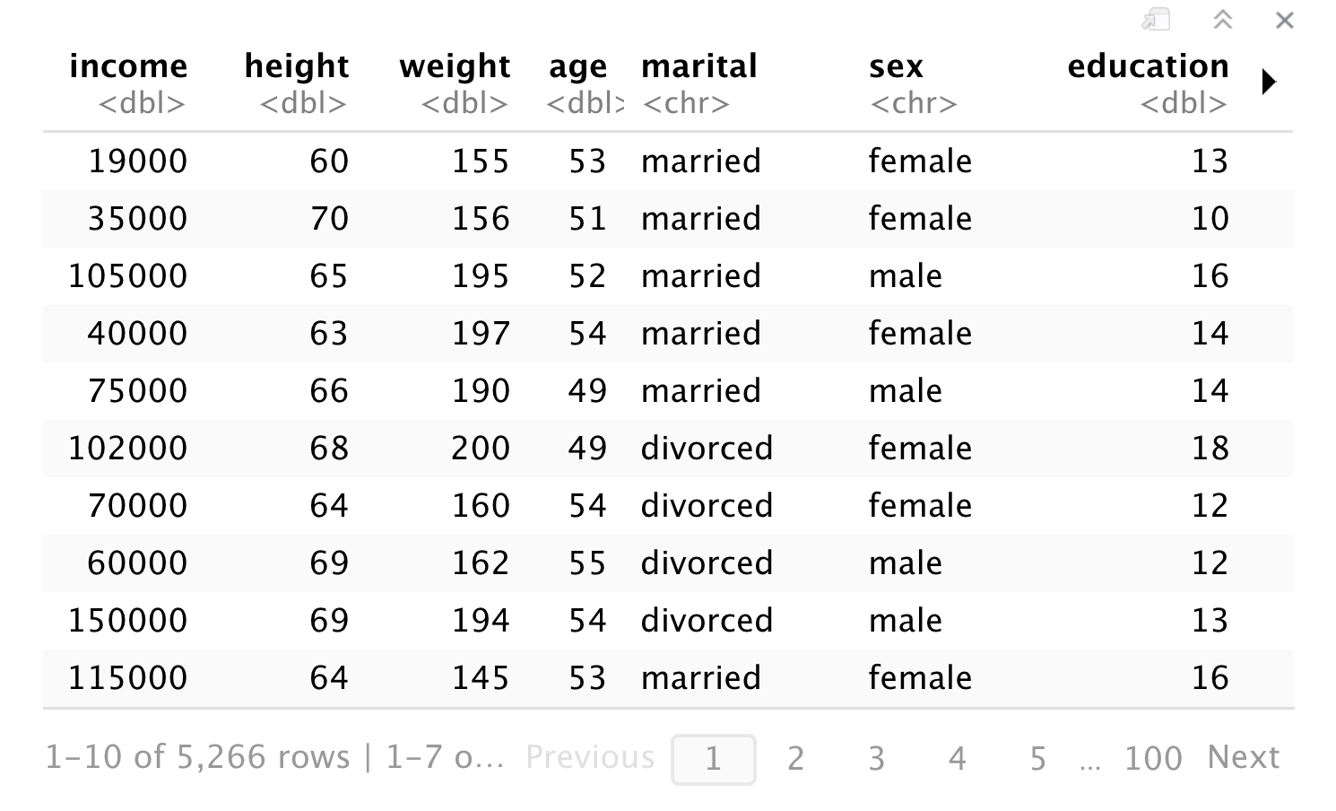
wages
CHaracter
modelr

Slide 46


factors
Discrete values, with an order (i.e. levels).
you can make with factor()
sexes <- factor(x = c("male", "female", "male"),
levels = c("male", "female", "other"))
sexes
## male female male
## Levels: male female other

Slide 47
factors
Stored as an integer vector with a levels attribute
unclass(sexes)
## 1 2 1
## attr(,"levels")
## "male" "female" "other"

Slide 48

To change the levels, refactor.
sexes <- factor(sexes, levels = c("male", "female", "other"))
sexes
## male female male
Levels: female male other
unclass(sexes)
## 2 1 2
## attr(,"levels")
## "female" "male" "other"
New Level order

Slide 49
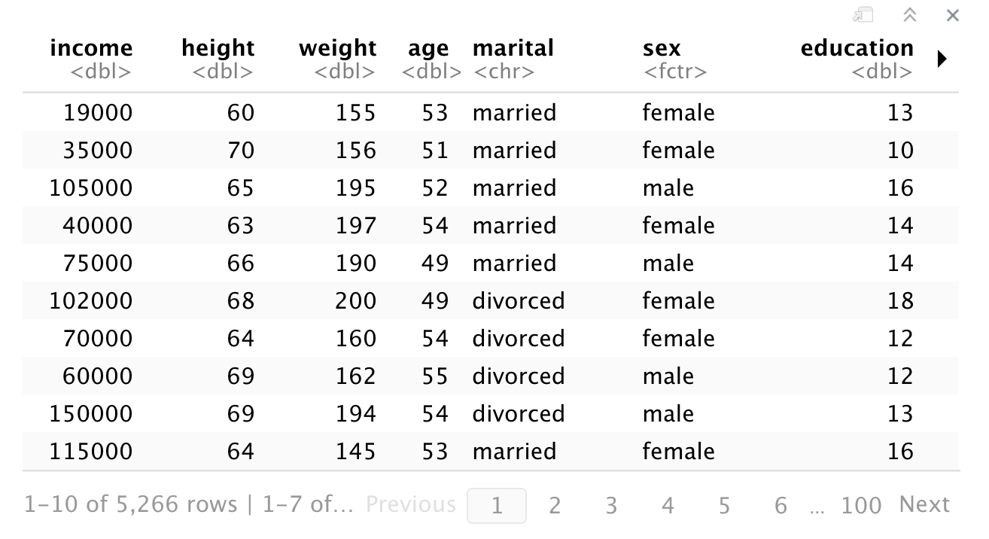
To change the order, make it a factor.
wages <-
wages %>%
mutate(sex = factor(sex, levels = c("male", "female")))
FACTOR

Slide 50
wages %>%
lm(log(income) ~ education + height + sex, data = .) %>%
tidy()
## term estimate std.error statistic p.value
## 1 (Intercept) 7.79 0.307 25.3 9.41e-134
## 2 education 0.148 0.00520 28.5 5.16e-166
## 3 height 0.00673 0.00479 1.40 1.61e- 1
## 4 sexfemale -0.462 0.0389 -11.9 5.02e- 32
But what does all of this look like?

Slide 51
model
visualization

Slide 52

Your Turn 5
Add + geom_smooth(method = lm) to the code below. What happens?
wages %>%
ggplot(aes(x = height, y = log(income))) +
geom_point(alpha = 0.1)

Slide 53
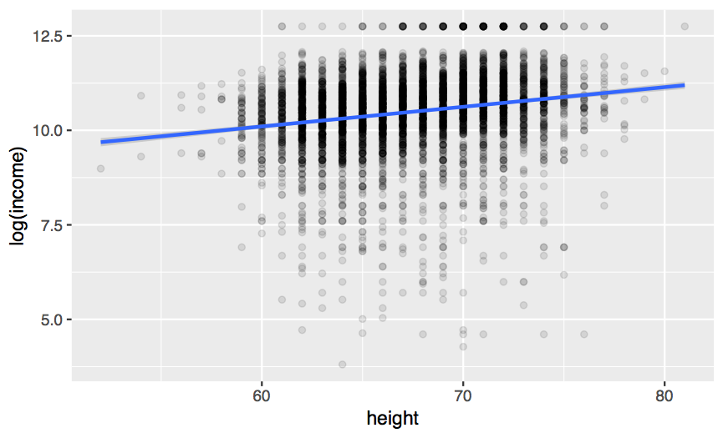

wages %>%
ggplot(aes(x = height, y = log(income))) +
geom_point(alpha = 0.1) +
geom_smooth(method = lm)
Fits y ~ x
(mod_h)

Slide 54
geom_smooth()
Adds model line for predicting y ~ x (default).
p + geom_smooth(method = lm, se = TRUE, …)
An R modeling function to use to generate the line
Include standard error bars?
Other args to pass to modeling function
What about complex
models, or residuals?

Slide 55
modelr
Tidy functions that make it easier to work with models in R
# install.packages("tidyverse")
library(modelr)
modelr
modelr

Slide 56
add_predictions()
Uses the values in a data frame to generate a prediction for each case. Overlaps with augment()*
add_predictions(data, model, var = "pred")
To add predictions to these cases
Gives new column this name
Uses this model
modelr

Slide 57
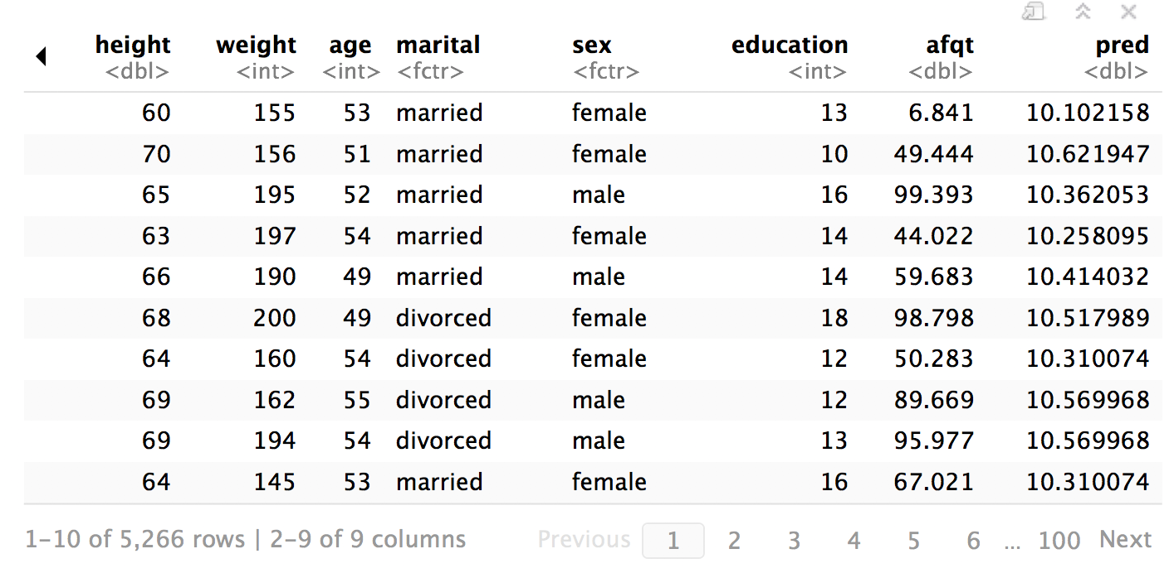
wages %>% add_predictions(mod_h)
modelr

Slide 58
add_residuals()
Uses the values in a data frame to generate a residual for each case. Overlaps with augment()*
add_residuals(data, model, var = "resid")
To add residuals to these cases
Gives new column this name
Uses this model
modelr

Slide 59
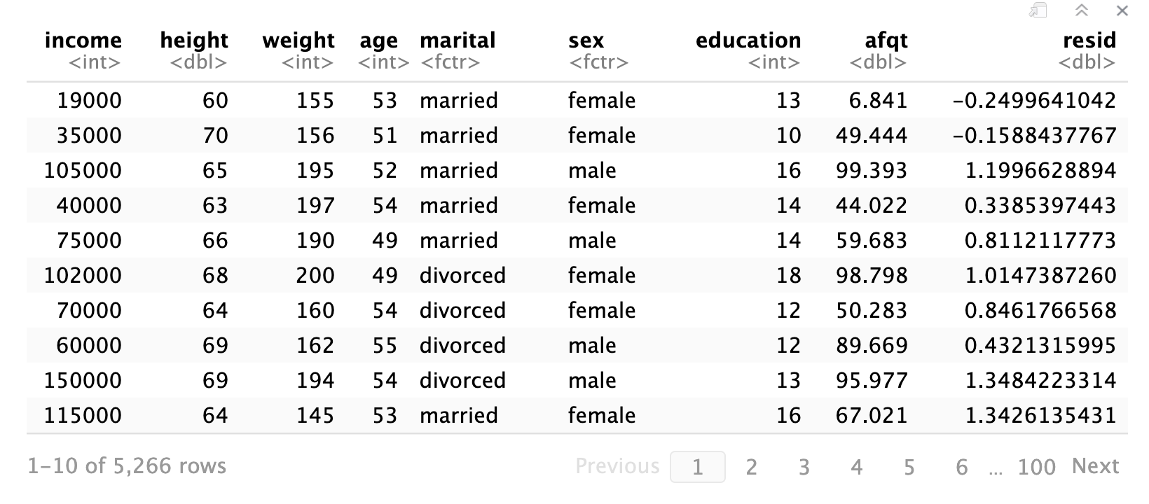
wages %>% add_residuals(mod_h)
modelr

Slide 60
Help Me
Help me add the predictions of mod_ehs and then visualize the results

Slide 61
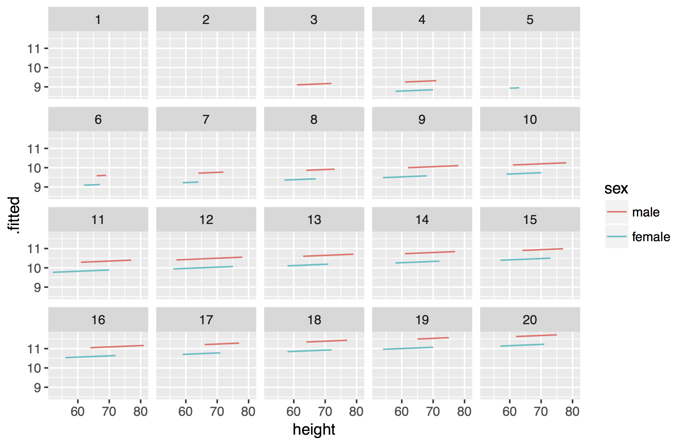
wages %>%
add_predictions(mod_ehs) %>%
ggplot(mapping = aes(x = height, y = pred, color = sex)) +
geom_line() +
facet_wrap(~ education)

Slide 63
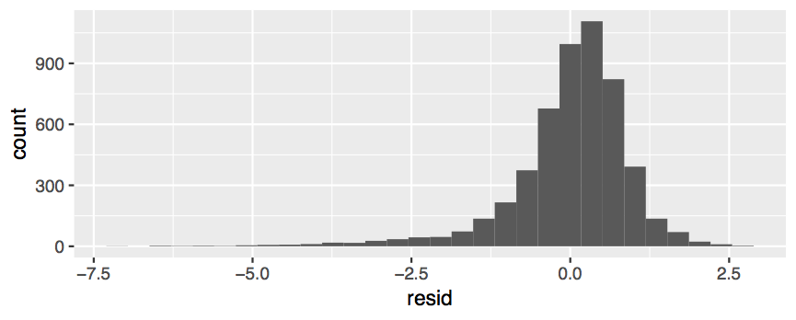
wages %>%
add_residuals(mod_ehs) %>%
ggplot() +
geom_histogram(aes(resid))

Slide 64
spread_residuals()
Adds residuals for multiple models, each in their own column.
spread_residuals(data, …)
To the cases in this data frame
Adds residuals from each of these models
modelr

Slide 65
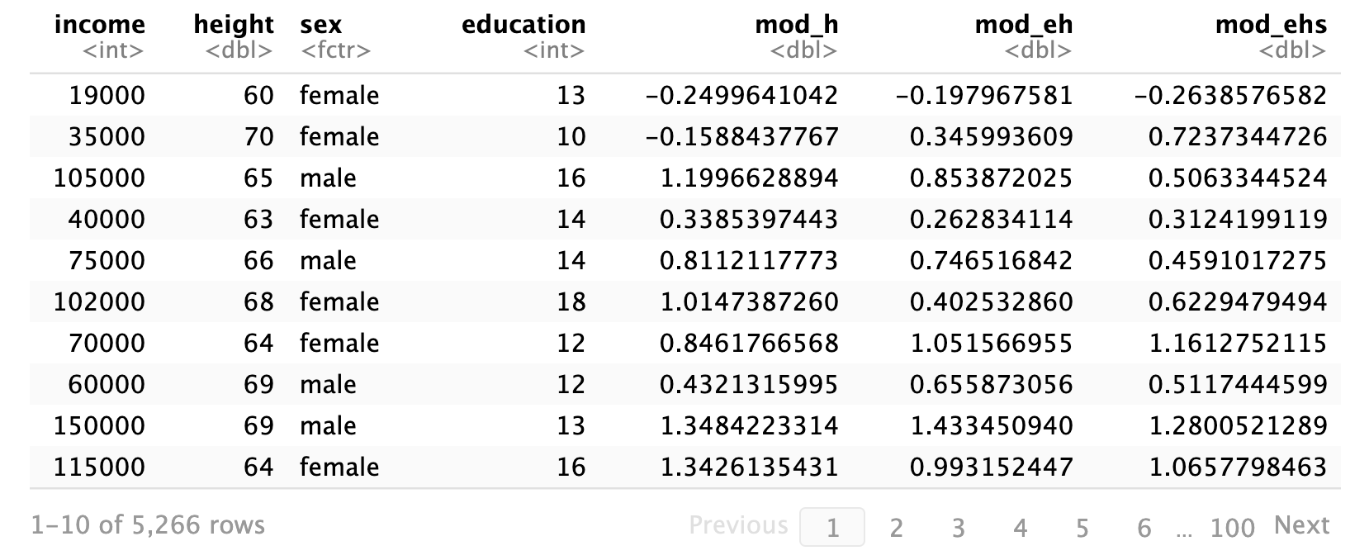
wages %>%
spread_residuals(mod_h, mod_eh, mod_ehs)
modelr

Slide 66
gather_residuals()
Adds residuals for multiple models as a pair of key:value columns (model:resid)
gather_residuals(data, …)
To the cases in this data frame (duplicating rows as necessary)
Adds residuals from each of these models
modelr

Slide 67
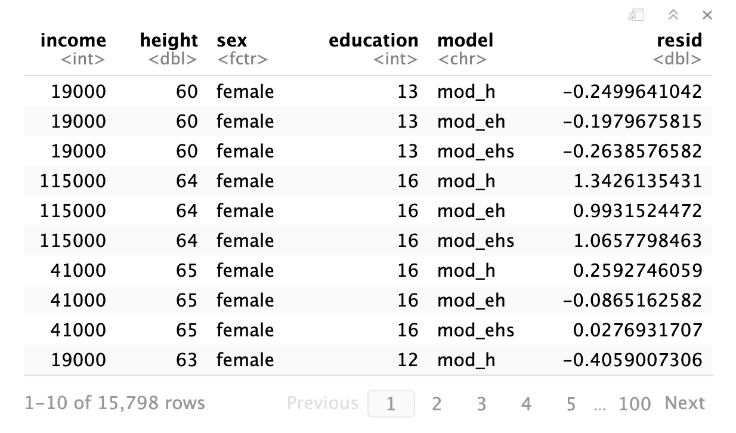
wages %>%
gather_residuals(mod_h, mod_eh, mod_ehs)
modelr

Slide 68
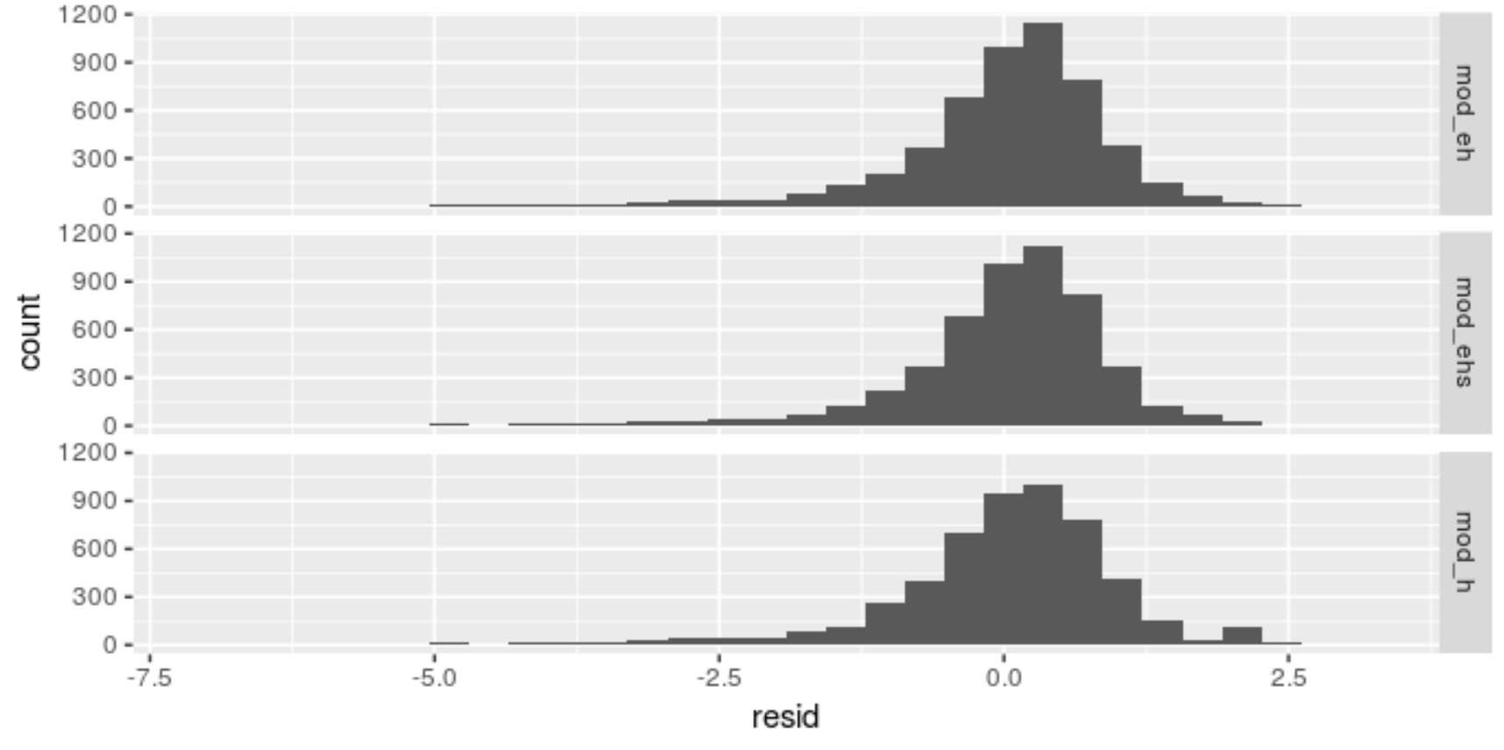

Your Turn 6
Complete the code skeleton: use gather_residuals to make the plot below.

Slide 69
wages %>%
gather_residuals(mod_h, mod_eh, mod_ehs) %>%
ggplot() +
geom_histogram(aes(resid)) +
facet_grid(model ~ .)
modelr

Slide 70
Predications
Modelr provides the equivalent functions for predictions
add_predictions()
spread_predictions()
gather_predictions()
add_residuals()
spread_residuals()
gather_residuals()
modelr

Slide 71
Recap
Use glance(), tidy(), and augment() to return model values in a data frame.
Use add_predictions() or gather_predictions() or spread_predictions() to visualize predictions.
modelr
Use add_residuals() or gather_residuals() or spread_residuals() to visualize residuals.
modelr

Slide 72
Modeling with
modelr

